Slide 1

SOVEREIGN ENGINE / IMPLEMENTATION BRIEF
CORE CONTRACT V0.1 · AUGUST 2026
DELIVERED
Python reference SDK and deterministic fixture corpus
[ EVIDENCE-FIRST BUILD SYSTEM ]
Evidence– Geometry Core
DELIVERED
Rust parity harness against shared vectors
NOW BOUNDED
Durable local evidence and audit primitives
A bounded executable kernel for canonical data, typed invariants, replayable evidence, and controlled subsystem growth.
DEFERRED
Production signing, network service, and quorum operation
Source → claim → core → evidence → adapter
01 / 10

Slide 2

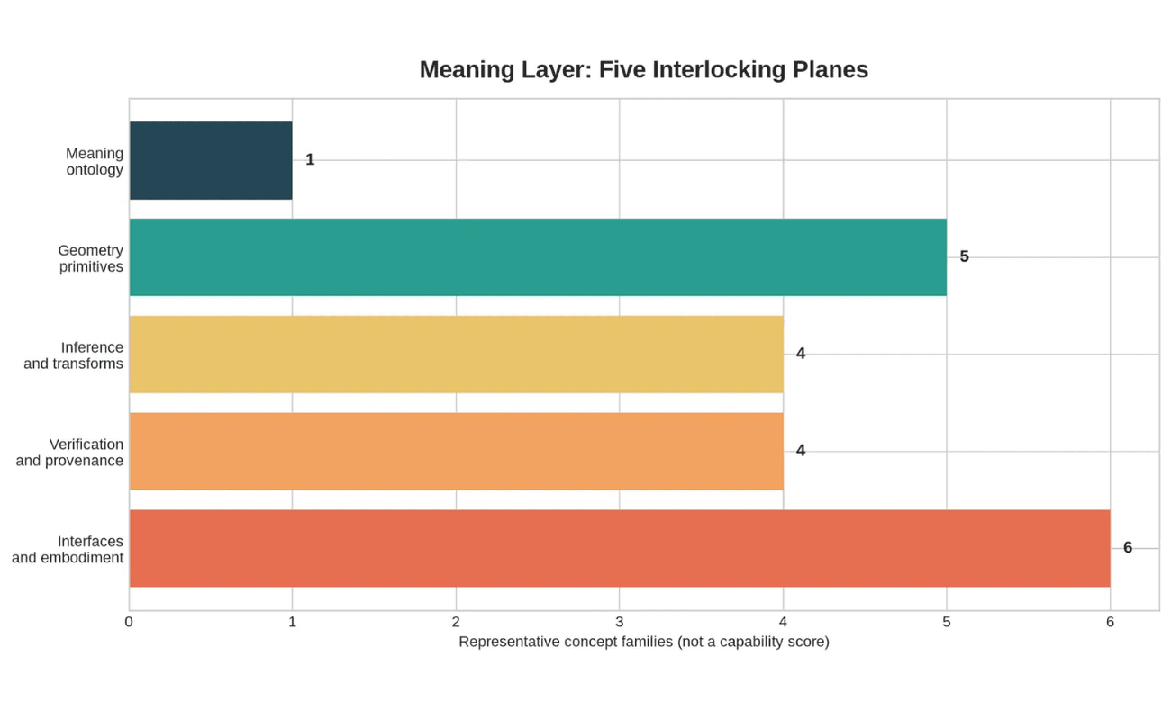
ARCHITECTURE POLICY / 01
Keep meaning, evidence, and adapters separate.
THE CORE IS THE ONLY VERDICT SETTER
Every higher layer may explain, store, transport, or inspect a result. None may silently upgrade it.
01
Source preserves originals and authority.
02
Claim records assumptions and falsifiers.
03
Core owns deterministic evaluation.
04
Evidence records outputs, reasons, and limits.
05
Adapter renders without mutating semantics.
PROHIBITED SHORTCUTS: UI default injection · dynamic evaluator loading · narrative-to-verdict promotion
Five planes / one-way authority
02 / 10

Slide 3

CORE CONTRACT V0.1 / DETERMINISTIC BOUNDARY
NO NETWORK · NO KEYS · NO MUTABLE VERDICT STATE
What is now deterministic.
canonical_body
→
JCS bytes
→
SHA-256
→
sov:sha256:<digest>
01 / CANONICALIZATION
02 / VALIDATION
03 / SCALARS
One byte representation
Schema + semantics
Exact by default
UTF-16 key order, duplicate-key rejection, UTF-8, and no raw mathematical floats.
Object shape is necessary; reference kinds, dimensions, slots, and scalar constraints are checked next.
Integers and reduced rationals support predicate meaning without hidden numerical drift.
04 / ERRORS
05 / RESULTS
06 / VERSIONING
Typed failure path
Three terminal states
Static registry
Unknown operation, missing reference, unsupported scalar, and predicate failure do not blur together.
verified
fail
unverifiable
Operations, conventions, schemas, and migrations are explicit artifacts—not dynamic imports or defaults.
Lifecycle and release state remain separate.
Contract semantics precede adapters
03 / 10

Slide 4

REFERENCE IMPLEMENTATION / PYTHON
Small enough to inspect. Strict enough to refuse.
SOV_EVIDENCE_GEOMETRY_CORE
Strict JSON intake
Two stores. One semantic boundary.
INPUT / 01
Reject duplicate keys, non-finite constants, and malformed document structure before semantics are considered.
PARSE_STRICT_JSON
Canonical representation
The in-memory store enables focused reference tests. The file store adds atomic local replay without modifying the object model.
BYTES / 02
Produce stable UTF-8 contract bytes; raw floating-point values are not admitted into mathematical payloads.
CANONICALIZE
Derived content ID
IDENTITY / 03
Bind canonical body to SOV:SHA256:<DIGEST>; a mismatched ID is a typed failure.
DERIVE_ID
REGISTERED CHECKS
tensor.dimension.v1
Schema + semantic validation
tensor.symmetry.v1
CONTRACT / 04
Check reference kinds, manifold dimensions, sparse components, scalar form, and status consistency.
VALIDATE_CORE_RECORD
metric.inverse.v1
connection.torsion_free.v1
Static invariant registry
evidence.replay.v1
EVALUATE / 05
Resolve only known operations. Unsupported requests become UNVERIFIABLE, never improvised execution.
REFERENCEINTERPRETER
EXCLUDED BY DESIGN: legacy runtime imports · agent calls · network I/O · key custody · dynamic evaluator loading · GU physical verdicts
Reference kernel / local-only / fail-closed
04 / 10

Slide 5

CROSS-LANGUAGE GATE / G2 FOUNDATION
FOCUSED CRATE · SOV-CONTRACT-PARITY
Rust parity: shared vectors, not parallel assumptions.
The Rust path does not invent its own fixtures. It consumes Python-reference objects, recomputes their canonical bytes and IDs, then reproduces the named invariant outcome.
→
→
01 / AUTHORITATIVE VECTOR
02 / SHARED ARTIFACT
03 / INDEPENDENT CHECK
Python reference
JSON vector set
Rust harness
Build immutable Core Contract records and scenario expectations from the same canonical object model.
Bind object bodies, final IDs, operation IDs, inputs, terminal status, and reason codes into one test corpus.
Recompute SHA-256 IDs and evaluate the bounded predicate subset without importing the legacy runtime.
SHARED INVARIANT SCENARIOS
PARITY SURFACES
2/2
metric inverse verified metric inverse fail tensor symmetry verified tensor symmetry fail unknown operation unverifiable
canonical bytes content IDs operation selection terminal status typed reason codes
RUST TESTS PASS canonical hash vector + cross-language scenarios
Parity claim: bounded vectors and predicates only
05 / 10

Slide 6

EVIDENCE PERSISTENCE / LOCAL REFERENCE IMPLEMENTATION
SINGLE WRITER · LOCAL FILESYSTEM · REPLAYABLE MANIFEST
Durable local evidence.
The persistence layer stores validated canonical records by content ID, then preserves a replayable local trail of exactly what was written.
→
→
→
→
01 / VALIDATE
02 / ADDRESS
03 / COMMIT
04 / REOPEN
05 / DETECT
Check before write
Content selects path
Atomic local write
Replay the ledger
Expose tampering
Schema, semantic references, and derived identity must resolve before bytes touch durable storage.
Canonical ID maps to an object path; identical content is idempotent, different bytes are rejected.
Temp file, file sync, atomic rename, then a canonical manifest entry form the local commit sequence.
A fresh store instance reads objects and recomputes the manifest root without relying on process memory.
Missing, altered, duplicated, or manifest-mismatched records stop verification with typed evidence errors.
EVIDENCE NOW SUPPORTED
BOUNDARY REMAINS EXPLICIT
Clean reopen, manifest replay, record-hash comparison, content-address collision detection, and a deterministic local root.
Not yet claimed: WORM media, replication, public transparency, distributed consensus, or cryptographic signing service.
Store is an adapter; canonical core semantics remain upstream
06 / 10

Slide 7

AUDIT LAYER / EXECUTABLE LOCAL PRIMITIVES
Executable audit primitives.
AUDIT STATUS ≠ CORE VERDICT
Bind exactly what was evaluated—then make the binding inspectable.
→
→
01 / BIND
02 / NAME
03 / COMMIT
DSSE PAE
Audit event
Merkle checkpoint
The audit layer begins after a core result exists. It never decides an invariant and never rewrites canonical evidence.
Pre-authentication encoding commits both payload type and exact serialized bytes.
Canonical event body receives a deterministic audit content identifier.
Domain-separated leaf and node hashes produce a local log root.
↓
LOCAL REFERENCE PROFILE single writer · unsigned events no public log · no key custody no production transparency claim
←
←
05 / REPLAY
04 / INSPECT
FAIL CLOSED
Consistency proof
Inclusion proof
Tamper detection
Prefix-replay checks that an earlier local tree is preserved by a later tree.
Audit path recomputes the named event’s membership in a checkpoint root.
Changed payload, leaf hash, path, root, or tree size returns a failed verification.
Implemented: DSSE PAE byte vector, events, checkpoints, inclusion and prefix-replay checks.
Bounded: audit attests to exact bytes and selected log history—not truth beyond the core scope.
Deferred: signatures, key policy enforcement, witnesses, public log operation, and production trust service.
Evidence first · signatures later · policy before network
07 / 10

Slide 8

VERIFICATION EVIDENCE / BOUNDARY STATEMENT
What the test evidence supports—and does not.
EVIDENCE IS SCOPED TO THE TESTED CONTRACT
EXECUTED AND REPRODUCIBLE
EXPLICITLY DEFERRED OR UNSUPPORTED
The implemented kernel is testable as software.
Passing software checks is not a universal truth claim.
16
Python focused tests: canonicalization, schemas, invariant outcomes, replay, persistence, audit proofs, and tamper cases.
No production signing. DSSE PAE is implemented; keys, signature policy, custody, and revocation are not.
02
Rust parity tests: exact canonical hash vector plus shared Python-generated IDs, statuses, and reason codes.
No network transparency service. The Merkle log is local, single-writer, and test-scoped.
No operating quorum. Multi-node aggregation remains an offline policy/profile specification.
17
Published fixture cases: valid objects, invalid requests, failed predicates, tamper, determinism, and unverifiable paths.
No physical validation claim. The work does not verify Geometric Unity or any external physical hypothesis.
01
Reusable skill validated: source authority, contract-first design, falsification, parity, and release gates.
Release rule: expand only when the next subsystem passes its own threat, oracle, and replay gate.
ASSERTION: these results support reproducibility of the named implementation paths and fixtures.
Implementation evidence ≠ physical interpretation
08 / 10

Slide 9

ARCHITECTURE AND RELEASE DISCIPLINE
Trust-order architecture and gates.
AUTHORITY FLOWS INWARD · ADAPTERS REMAIN OUTSIDE
Build outward from the deterministic core; never use a later layer to patch an earlier ambiguity.
01
Core Contract and static predicates establish the only verdict boundary.
02
Persistence proves selected evidence can survive clean local replay.
03
Audit binds exact events to checkpoints and proof verification.
04
Offline quorum may aggregate compatible signed results under a separate policy.
05
API, dashboard, and explanations are read-only adapters to evidence semantics.
G1 / DETERMINISM
Canonical bytes, IDs, fixtures, typed errors.
G2 / PARITY
Python and Rust agree on shared vectors.
G3 / REPLAY
Clean restore reproduces stored evidence and manifest root.
G4 / AUDIT
Payload binding and proof tamper cases fail closed.
DEFERRED: production signing · network log · quorum operation · P2P/consensus. Their policy and threat gates are not satisfied by core tests.
Core → persistence → audit → offline quorum → read-only adapters09 / 10

Slide 10

PROGRAM SEQUENCE / NEXT GATED WAVE
Advance only when the invariant survives.
NO FEATURE LEAPFROG
The path is intentionally narrow: each layer earns the right to exist by preserving the core contract beneath it.
→
→
→
→
G2 / PARITY
G3 / REPLAY
G4 / AUDIT
G5–G7 / EXTERNALIZE
NOW / REFERENCE
Broaden Rust agreement
Durable restore
Policy before signatures
Quorum and release
Bounded core
Clean restore must recreate selected evidence, manifest roots, and tamper detection under controlled failure cases.
Python SDK, Rust parity harness, local persistence, and audit primitives are executable and test-scoped.
Match canonical bytes, IDs, errors, and additional invariant fixtures before a dual-core release claim.
Accept threat model, key policy, signing fixtures, proof tests, and incident drill before attestation expansion.
Offline threshold tests, user auditability, reproducible release packet, then a go/no-go for service exposure.
MANDATORY STOP CONDITIONS
STILL DEFERRED
Pause and reopen the prior gate if canonical bytes diverge, IDs collide, an oracle is absent, a proof is unverifiable, an explanation hides its limit, or a policy is ambiguous.
Public signing · key custody · network log · P2P consensus · production quorum · physical-claim evaluator.
Core → persistence → audit → offline quorum → adapter / release
10 / 10

